Slide 1
Open-SingSong
:An Implementation of 'SingSong: Generating Musical Accompaniments from Singing’
2024 Winter Intern
Jihoo Jung
2024.2.26

Slide 2
Table of Contents
Introduction
Related Works
Methods
Experiments and Results
Discussion and Future Works

Slide 3
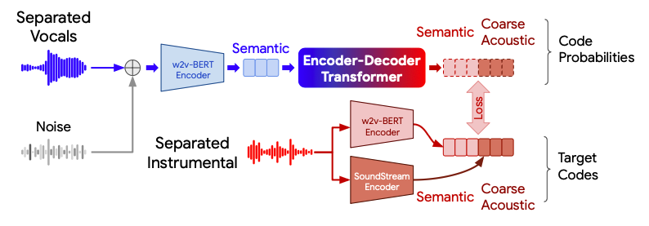
1. Introduction
The paper titled 'SingSong: Generating Musical Accompaniments from Singing' by Google Research explores the creation of instrumental music to accompany input vocals using Transformer. Since the code for this paper wasn't made open-source, we attempted to implement the described methods with a few modifications.
[1]
[1] Donahue, C., Caillon, A., Roberts, A., Manilow, E., Esling, P., Agostinelli, A., Verzetti, M., Simon, I., Pietquin, O., Zeghidour, N., & Engel, J. (2023). SingSong: Generating musical accompaniments from singing. arXiv preprint arXiv:2301.12662.

Slide 4
2. Related Work
Accompaniment generation
Audio to Audio Generation with Transformers
AudioLM, MusicLM
Neural Codec
SoundStream, Encodec
Audio Representation with Language Modelling
MERT

Slide 5
3. Methods
We initially attempted to adhere closely to the methodology outlined in the original SingSong paper. However, due to the substantial size of the model proposed in the original paper, we encountered difficulties in training it effectively with our limited computational resources.
As an alternative, we attempted to leverage a pre-trained model for AudioLM, as referenced in the original paper. However, since this model was not publicly accessible, we opted to utilize unofficial pre-trained weights for MusicLM, a closely related model to AudioLM. Subsequently, we adapted our model architecture to accommodate these unofficial pre-trained weights for MusicLM.
We'll employ two models for the implementation of Singsong:
Open-musiclm: An unofficial implementation of the MusicLM paper, complete with pre-trained weights. We'll utilize this without any modifications.
Our semantic model: Developed by us, this model predicts instrumental semantic tokens from MERT based on vocal input.

Slide 6
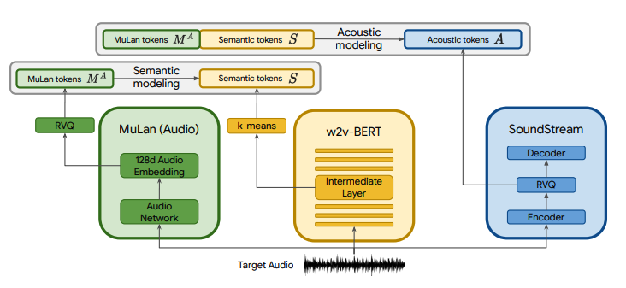
3. Methods
3.1 open-musiclm
[1]
Clap Tokens
Semantic Tokens
Acoustic
modeling
Acoustic Tokens
Pytorch implementation of MusicLM, a SOTA text to music model published by Google with a few modifications.
Mulan-> Clap
SoundStream-> Encodec
w2v-BERT-> MERT
Pretrained weight is released.
Clap Tokens
Semantic
modeling
Semantic Tokens
Clap
K-means
Mert
Encodec
RVQ
Decoder
512 Audio
Embedding
Intermediate
Layer
RVQ
Audio
Network
Encoder
Target Audio
[1] Zhong, V. (Year, Month Day). Open-MusicLM. GitHub Repository. Retrieved from https://github.com/zhvng/open-musiclm

Slide 7
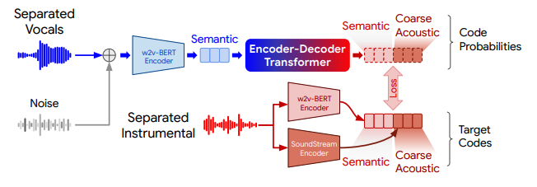


3. Methods
3.2 Our Semantic Model
Given vocal input, the model predicts instrumental semantic tokens. Our decoder-only transformer utilizes vocal semantic tokens and coarse acoustic tokens as conditions to predict instrumental semantic tokens.
Separated
Vocals
Mert with Kmeans
Semantic
Decoder Only
Transformer
Code
Probabilities
Semantic
Coarse
Acoustic
Encodec
Loss
Separated
Instrumental
Mert with
Kmeans
Target
Codes
Semantic

Slide 8


3. Methods
3.3 Inference
During inference, we feed vocals into our semantic model to obtain the predicted instrumental semantic tokens. Simultaneously, we extract clap tokens from the text input, ‘Diverse kinds of instruments and richness.' These two sets of tokens are concatenated and inputted into the acoustic model of open-musiclm. The resulting acoustic tokens are then decoded using Encodec to produce the final waveforms of the generated instrumental sound.
Separated
Vocals
Our semantic model
Instrumental
Semantic
Instrumental
Acoustic
Generated
Instrumental
open-musiclm
Acoustic Modeling
Text input :
”Diverse kind of
instrument and richness”
open-musiclm
Clap with RVQ
Clap Tokens

Slide 9
4. Experiments and results
4. Experiments and Results
4.1 Datasets
MUSDB18 dataset : 10 hours of professional studio- isolated vocal and instrumental from 150 source mixes.
Filtering data : Non-overlapping 5s clips are extracted from each mix, specifically targeting segments where vocals are discernible. Vocal presence is defined as a peak RMS amplitude exceeding −25dB relative to line level.
Total clips : 2845 for training, 150 for validation, 1693 for test
[1]
[1] Rafii, Z., & Liutkus, A. (2017). MUSDB18: A Dataset for Musical Source Separation. In Proceedings of the 18th International Society for Music Information Retrieval Conference (ISMIR). Retrieved from https://sigsep.github.io/datasets/musdb.html

Slide 10
4. Experiments and results
4. Experiments and Results
4.2 Model Selection and Training Details
Semantic Tokens
Model: MERT (MERT-v0 in HuggingFace)
7th Embedding Layer quantized with k-means
Acoustic Tokens
Model: Encodec (24kHz)
3 Coarse quantizers, 5 Fine quantizers
My Semantic Model Specifications
24 layers, 16 attention head Decoder-only Transformer with embedding dimension of 1024
Training Details:
Steps: 5k steps
Batch Size: 2 with 64 gradient accumulations
Learning Rate: 0.0003 (Learning rate warmup of 6000 steps)
[1]
[2]
[1] Li, Y., Yuan, R., Zhang, G., Ma, Y., Chen, X., Yin, H., Xiao, C., Lin, C., Ragni, A., Benetos, E., Gyenge, N., Dannenberg, R., Liu, R., Chen, W., Xia, G., Shi, Y., Huang, W., Wang, Z., Guo, Y., & Fu, J. (2024). MERT: Acoustic Music Understanding Model with Large-Scale Self-supervised Training. arXiv preprint arXiv:2306 .00107 [cs.SD].
[2] Défossez, A., Copet, J., Synnaeve, G., & Adi, Y. (2022). High Fidelity Neural Audio Compression. arXiv preprint arXiv:2210.13438 [eess.AS].

Slide 11

4. Experiments and results
4. Experiments and Results
4.3 Demo – training dataset
Ground Truth
Open-Singsong

Slide 12
4. Experiments and results
4. Experiments and Results
4.3 Demo – test dataset
Ground Truth
Open-Singsong

Slide 13
4. Experiments and results
5. Discussion and Future Works
Discussion
The results were quite overfitted to the training dataset.
There is an issue with the alignment of the rhythm of vocals and the generated music.
Possible Reasons for Bad Result
The reason why the model doesn’t work properly is that we didn’t predict instrumental coarse features from the input vocals. The original SingSong paper predicts instrumental semantic and coarse tokens from vocal semantic tokens, while we predict only instrumental semantic tokens from vocal semantic and coarse tokens. This decision was made because we aimed to reuse the pretrained weights released by open-musiclm, but might causes alignment of rhythm issue.
Future works
Include prediction of instrumental coarse features alongside vocals coarse, vocals semantic, and instrumental semantic.
Evaluate the model using the FAD score.

Slide 14
Project Repository
Please refer to my github repository(https://github.com/jihoojung0106/open-singsong) for more information.

Slide 15
References
References
Donahue, C., Caillon, A., Roberts, A., Manilow, E., Esling, P., Agostinelli, A., Verzetti, M., Simon, I., Pietquin, O., Zeghidour, N., & Engel, J. (2023). SingSong: Generating musical accompaniments from singing. arXiv preprint arXiv:2301.12662.
Zhong, V. (Year, Month Day). Open-MusicLM. GitHub Repository. Retrieved from https://github.com/zhvng/open-musiclm
Rafii, Z., & Liutkus, A. (2017). MUSDB18: A Dataset for Musical Source Separation. In Proceedings of the 18th International Society for Music Information Retrieval Conference (ISMIR). Retrieved from https://sigsep.github.io/datasets/musdb.html
Li, Y., Yuan, R., Zhang, G., Ma, Y., Chen, X., Yin, H., Xiao, C., Lin, C., Ragni, A., Benetos, E., Gyenge, N., Dannenberg, R., Liu, R., Chen, W., Xia, G., Shi, Y., Huang, W., Wang, Z., Guo, Y., & Fu, J. (2023). MERT: Acoustic Music Understanding Model with Large-Scale Self-supervised Training. arXiv preprint arXiv:2306 .00107 [cs.SD].
Défossez, A., Copet, J., Synnaeve, G., & Adi, Y. (2022). High Fidelity Neural Audio Compression. arXiv preprint arXiv:2210.13438 [eess.AS].
Borsos, Z., Marinier, R., Vincent, D., Kharitonov, E., Pietquin, O., Sharifi, M., Roblek, D., Teboul, O., Grangier, D., Tagliasacchi, M., & Zeghidour, N. (2022). AudioLM: a Language Modeling Approach to Audio Generation. arXiv preprint arXiv:2209.03143 [cs.SD].
Agostinelli, A., Denk, T. I., Borsos, Z., Engel, J., Verzetti, M., Caillon, A., Huang, Q., Jansen, A., Roberts, A., Tagliasacchi, M., Sharifi, M., Zeghidour, N., & Frank, C. (2023). MusicLM: Generating Music From Text. arXiv preprint arXiv:2301.11325 [cs.SD].

